Slide 1


Models of ANNs
=============================================================================
WWW.THEMLLABS.COM || contact@themllabs.com || Phone : 91-7338339898, 91-6362546088

Slide 2
Agenda
What is ANN
Networks for Binary data
Networks for Continuous data
=============================================================================
WWW.THEMLLABS.COM || contact@themllabs.com || Phone : 91-7338339898, 91-6362546088

Slide 3
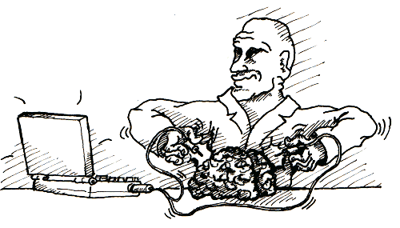
Artificial Neural Network (ANN)
ANNs are similar to the Biological Neural Network.
These neural networks are created by humans to pass the information to the next neuron hence the name artificial.
ANNs are some kind of non-linear statistics for amateurs
=============================================================================
WWW.THEMLLABS.COM || contact@themllabs.com || Phone : 91-7338339898, 91-6362546088

Slide 4
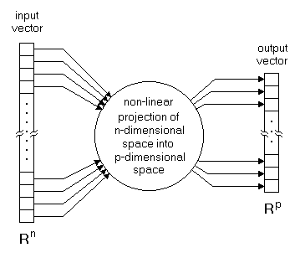
ANN creates non relational mapping between n-dimensional inputs and p-dimensional outputs.
=============================================================================
WWW.THEMLLABS.COM || contact@themllabs.com || Phone : 91-7338339898, 91-6362546088

Slide 5
Normally, input dimensions are greater than output dimensions.
Mapping inputs and outputs represents the relationship within the data, avoiding the adjustment for noise and errors in the data.
=============================================================================
WWW.THEMLLABS.COM || contact@themllabs.com || Phone : 91-7338339898, 91-6362546088

Slide 6
Networks for Binary data
Binary data is a one which is represented in binary numerical system. These data are easily understood by computer.
For Binary type training data, the ANN training methods are Supervised method and Unsupervised method.
=============================================================================
WWW.THEMLLABS.COM || contact@themllabs.com || Phone : 91-7338339898, 91-6362546088

Slide 7
Supervised method: in these method, the inputs are mapped to outputs by a relation or function (Y = mX + c).
Example models: Hopfield network, BAM
=============================================================================
WWW.THEMLLABS.COM || contact@themllabs.com || Phone : 91-7338339898, 91-6362546088

Slide 8
Unsupervised method: in these method, the model will try to find the underlying structure inside the data. It can also be called as binary classifier.
Example models: Carpenter classifier or Grossberg classifier
=============================================================================
WWW.THEMLLABS.COM || contact@themllabs.com || Phone : 91-7338339898, 91-6362546088

Slide 9
Networks for Continuous data
Continuous data is a data which can take any value within the range. It can be measured in an infinite scale.
For Continuous type training data, the ANN training methods are again discriminated as Supervised method and Unsupervised method.
=============================================================================
WWW.THEMLLABS.COM || contact@themllabs.com || Phone : 91-7338339898, 91-6362546088

Slide 10
Supervised method: in these method, the inputs are mapped to outputs by a relation or function (Y = 1 + 2X).
Example models: Multi Layer perceptron, DCA network
=============================================================================
WWW.THEMLLABS.COM || contact@themllabs.com || Phone : 91-7338339898, 91-6362546088

Slide 11
Unsupervised method: in these method, the model will try to find the underlying structure inside the data. In continuous data, there are number of groups for the data.
Example models: Kohonen feature map
=============================================================================
WWW.THEMLLABS.COM || contact@themllabs.com || Phone : 91-7338339898, 91-6362546088

Slide 12
Thank you
=============================================================================
WWW.THEMLLABS.COM || contact@themllabs.com || Phone : 91-7338339898, 91-6362546088

